Slide 1

Major Project Presentation on
IMPLEMENTATION OF CRDT IN REAL-TIME COLLABORATIVE APPLICATOINS
BY
TARAKANT SETH 18WJ1A05Y3
VARUN PAPISHETTY 18WJ1A05Z5
Under the Esteemed Guidance Of
Mr. V. DEVASEKHAR,
Head Of The Department, CSE.
GURU NANAK INSTITUTIONS TECHNICAL CAMPUS (AUTONOMOUS)
School of Engineering and Technology
Ibrahimpatnam, R.R District- 501506
2021-2022

Slide 2
OVERVIEW
Abstract
Objective
Introduction
Existing System
Proposed System
Algorithm
System Architecture
ER, UML and Data Flow Diagrams
Screenshots
Conclusion
Future Enhancements

Slide 3
ABSTRACT
Real-time collaborative applications allow users to edit a shared document concurrently and see each other's changes in real-time. Most collaborative applications such as apache wave, etherpad, google docs, uses OT (operational transformation) based algorithms which rely on a single server, with no peer-to-peer collaboration, which hinders the user's privacy.
CRDT (conflict-free replicated data type) is a family of data structures that support concurrent transformation and ensure convergence of concurrent updates and works by attaching additional metadata to the data structure, making modification operations commutative by construction.
In this project, we use CRDTs for implementing a general-purpose data store that supports real-time collaborative editing of semi-structured data. The intent of the data store is that it drastically streamlines the development of collaborative and state-synchronizing applications for mobile devices with poor network connectivity, in peer-to-peer networks, and in applications systems with end-to-end encryption.

Slide 4
INTRODUCTION
Collaboration through software is a core part of many peoples lives.
The most advanced types of such collaborative software are those that support real-time collaborative editing, i.e. that multiple users can edit the same document simultaneously and see each other's changes in real-time.
A popular example of a real-time collaborative product is Google Docs. It achieves eventual consistency by using a technique called Operational transformation (OT).
However, more recent advancements in distributed systems that promise strong eventual consistency are conflict-free replicated data types (CRDTs).
CRDTs is a collective term for data structures that can be replicated across nodes and guarantees that any nodes that have received the same updates will end up in the same state.

Slide 5
OBJECTIVE
The objective of this project is to build a real-time collaborative editing application that uses conflict-free replicated data types (CRTDs).
The theoretical part of the project is to identify the requirements of such an application, identify challenges, explore different solutions and proposed implementation strategies.
Decentralized server
Better privacy

Slide 6
EXISTING SYSTEM
In a real-time collaboration system, all the application state needs to imitate several devices, which may modify the state locally. Due to the conventional approach towards concurrency management and serialization, an application becomes unstable.
Existing system disadvantages
Treats a document as single ordered list
No support for nested tree structure
Lack of peer-to-peer collaboration without server
Algorithms are mostly proprietary
Privacy issues

Slide 7
PROPOSED SYSTEM
The proposed system allows messages to be delivered through an ad-hoc network as well as a secure messaging protocol with end-to-end encryption.
Proposed system advantages
Replication and conflict resolution
Uses JSON format
Uses decentralized network
Better privacy

Slide 8
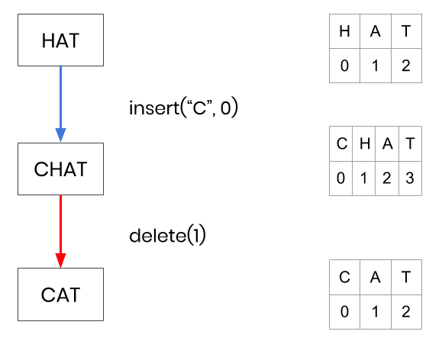
ALGORITHM FOR NORMAL TEXT EDITOR
FIG : INSERTRION AND DELETION IN THE NORMAL TEXT EDITOR

Slide 9
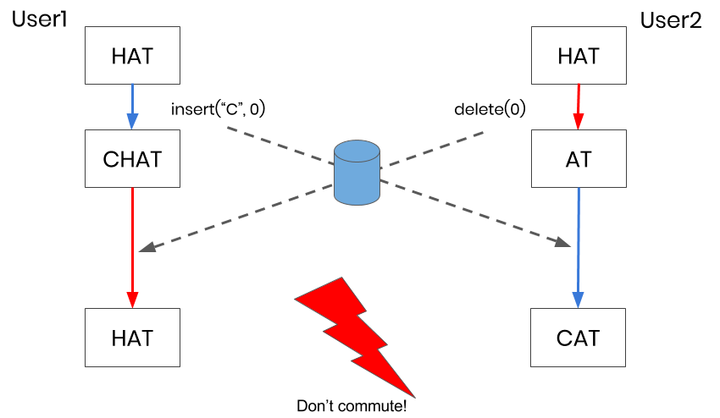
INSERTRION AND DELETION USING CRDT

Slide 10
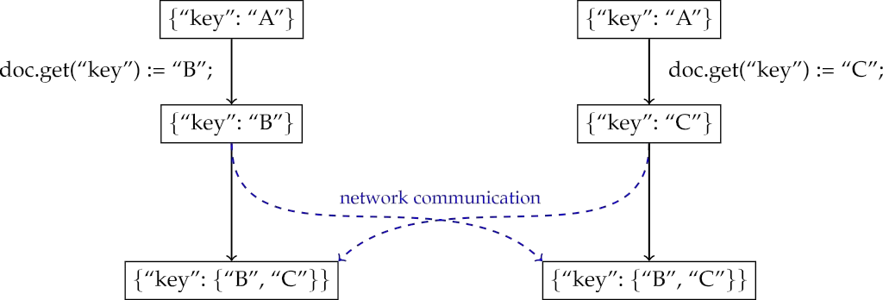
EXAMPLE
Fig : Concurrent assignment to the register at doc.get(“key”) by replicas p and q.

Slide 11
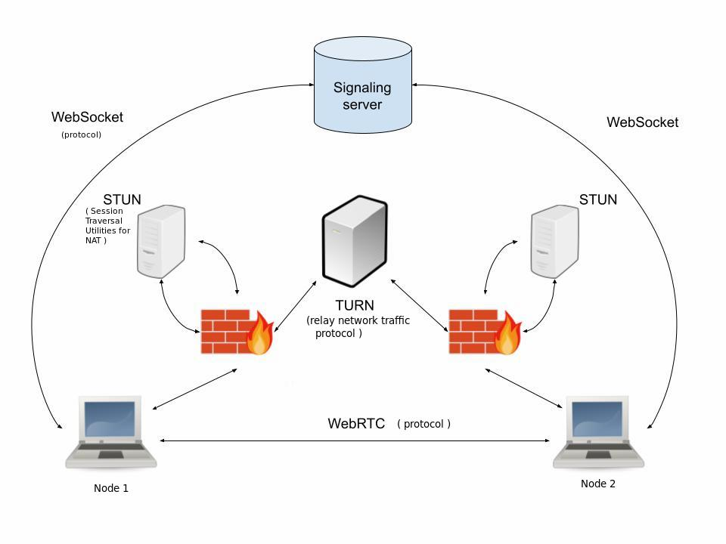
ARCHITECTURE

Slide 12
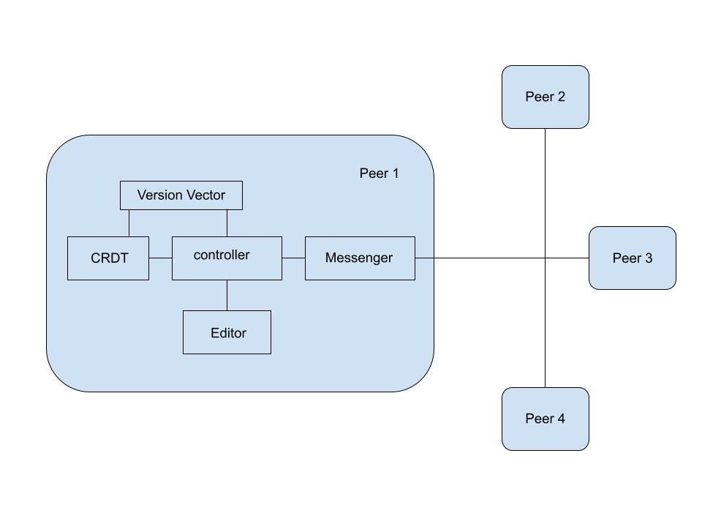
FINAL ARCHITECTURE

Slide 13
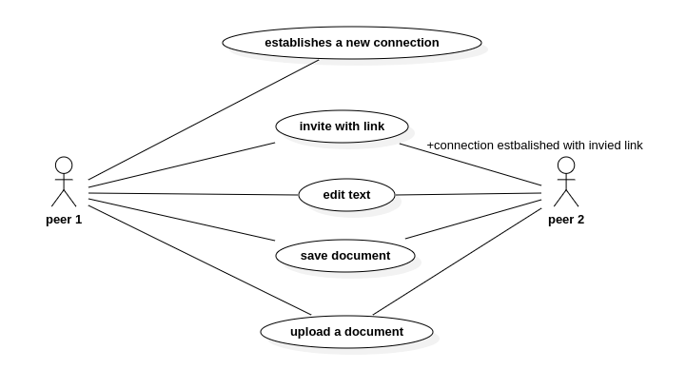
USE-CASE DIAGRAM

Slide 14
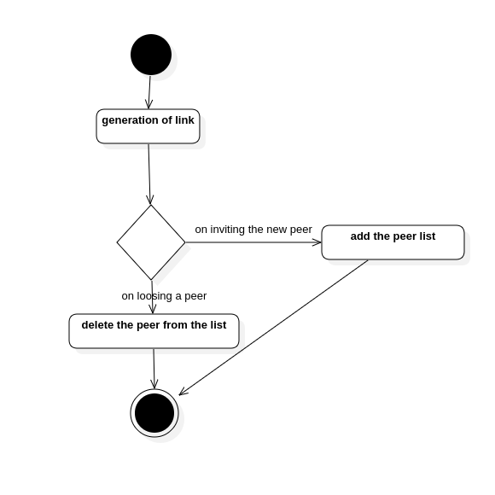
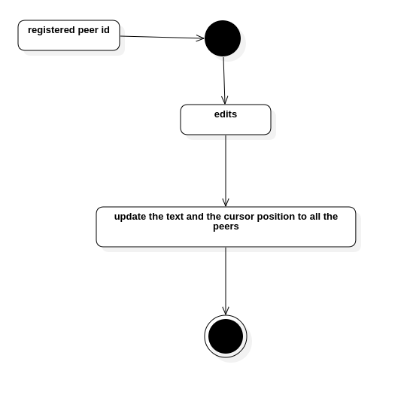
ACTIVITY DIAGRAM

Slide 15
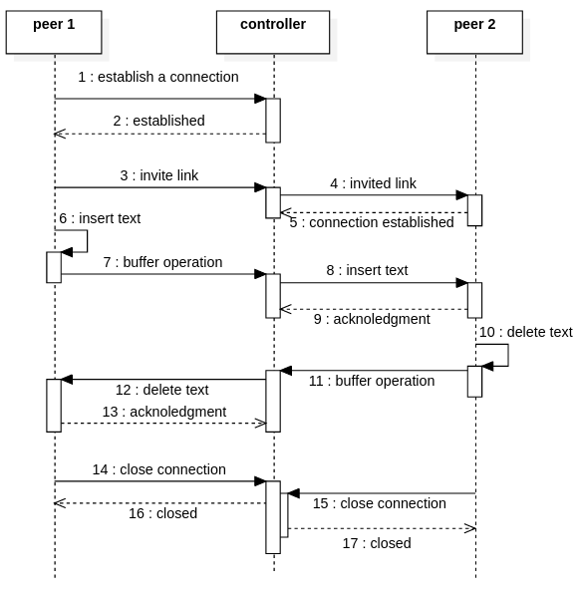
SEQUENCE DIAGRAM

Slide 16
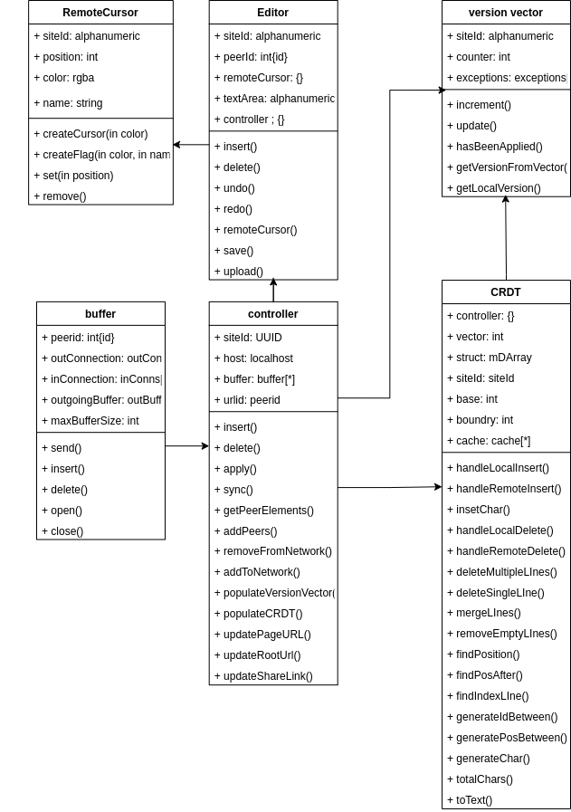
CLASS DIAGRAM

Slide 17
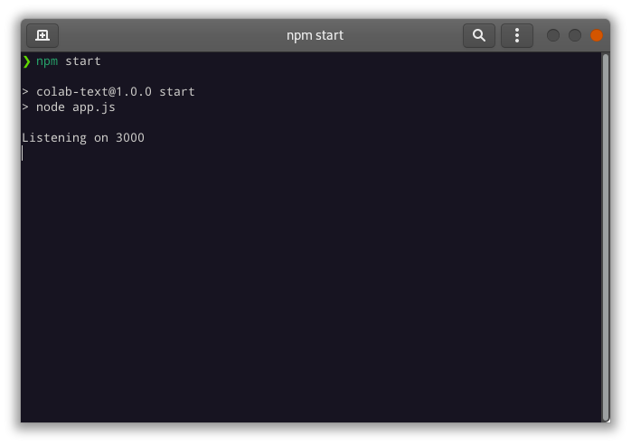
SCREENSHOTS
local server running at port 3000 as shown in the screenshot above.
The application can be assesed with the localhost://3000 in the browserer

Slide 18
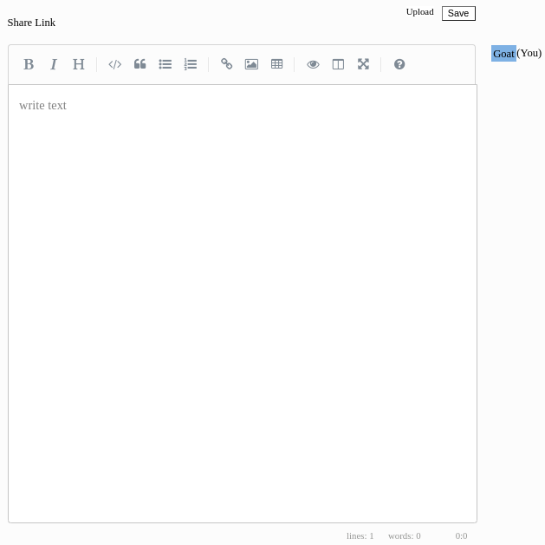

Slide 19
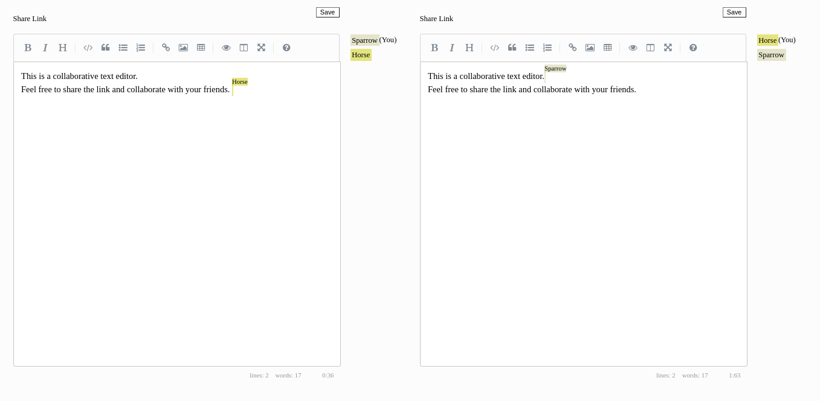

Slide 20
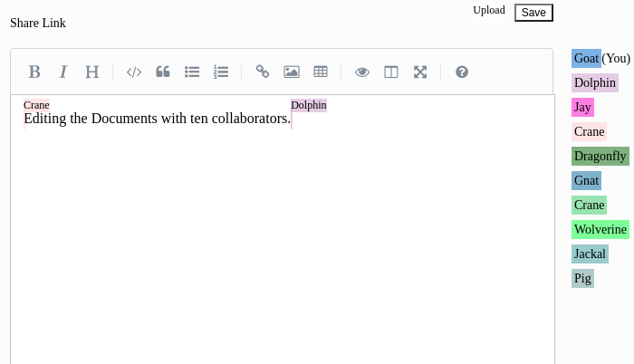

Slide 21
CONCLUSION
The objective of this project was to implement CRDT in the real world applications for a general purpose collaborative text editor.
The development of this project taught us few libraries and packages that we have almost never heard of like PUG for efficient layout editing, ExpressJS for the better backend support with NodeJS, jQuery for the better javascript features.
Even though the project is not as elegant as most commercialized editors, adding new features and the functionalities will be carried on continuously.

Slide 22
FUTURE ENHANCEMENTS
Better Connection Distribution
The first thing to further improve would be the connection distribution for users in the network. A possibility we are entertaining is to have new users connect to more than one user initially. This will prevent collaborators from becoming stranded if one of their connections drops and they are forced to find a new user to connect to.
Large Insertions/Deletions
Currently, our CRDT can only insert and delete one character at a time. Being able to add or remove chunks of text at once will drastically improve overhead and improve the efficiency of large cuts and pastes (as well as uploads).
Comments
This feature would allow the collaborators to comment on the documents lines or text. This would really improve the quality of collaborations.
Suggests edits
Suggest edits are the recommendations that are given by the users to other users for enhancing their part of the documents. Generally very helpful while large no of collaborations in bigger documents.

